Slide 1


Visual Basic .NET For Intermediate :
(Data Set)
Universitas Gunadarma
Lembaga Pengembangan Komputer
Anugerah Cahaya Utama

Slide 2
Materi Presentasi
Panduan Activity

Slide 3
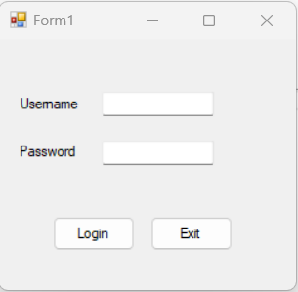
Panduan Activity (Output Program)

Slide 4
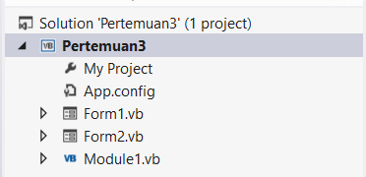
Panduan Activity (Struktur Project)

Slide 5
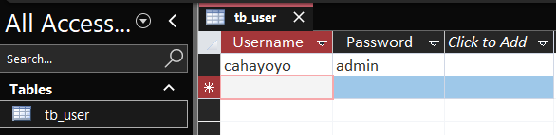
Panduan Activity (Database MS Access)

Slide 6
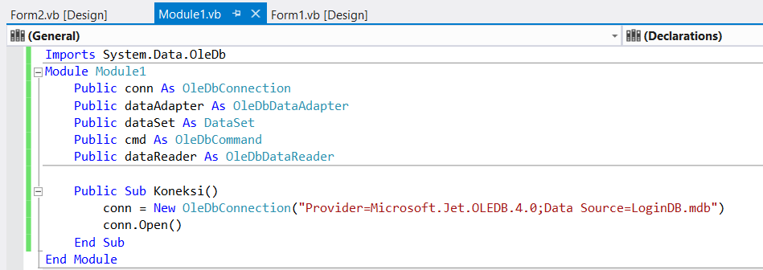
Panduan Activity (Codingan Module 1)

Slide 7
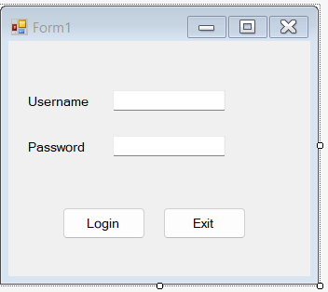
Panduan Activity (Design Form 1)

Slide 8
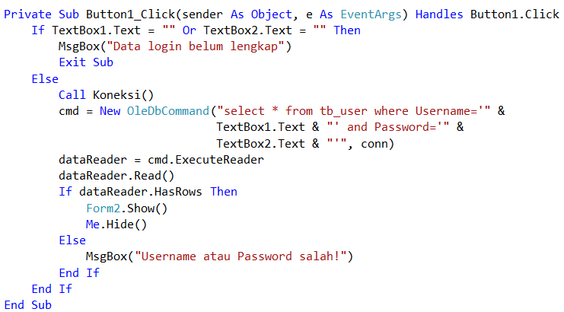
Panduan Activity (Codingan Button 1)

Slide 9

Panduan Activity (Codingan Button 2)

Slide 10
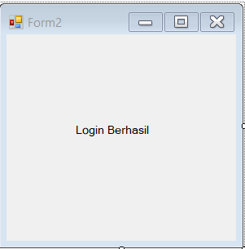
Panduan Activity (Design Form 2)

Slide 11
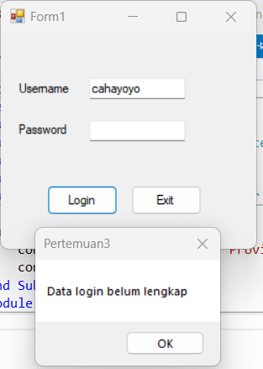
Panduan Activity (Screenshot Belum Lengkap)

Slide 12
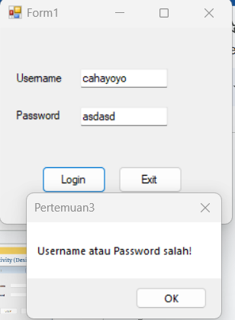
Panduan Activity (Screenshot Salah)

Slide 13
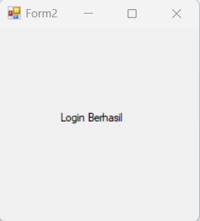
Panduan Activity (Screenshot Berhasil)

Slide 14
Panduan Activity (Screenshotan)
Database di Microsoft Access
Saat mengkoneksikan database
Output belum lengkap
Output salah
Output berhasil
Codingan Module 1
Codingan Button 1
Codingan Button 2

Slide 15

Thank You
https://vm.lepkom.gunadarma.ac.id/
cahayoyo@gmail.com
Anugerah Cahaya Utama

